Slide 1
OGE SUMMIT
Post-Government Service Employment Restrictions

Slide 2
Road Map
Purpose of Restrictions
Federal Employment Restrictions

Slide 3
Purpose of Restrictions
Prevent conflicts of interest
Promote economy in Federal Government
Expand employment opportunities in the Federal system
Preserve public confidence in Government integrity

Slide 4
Retired At Last!!!
Transition

Slide 5

Representational Restrictions
18 U.S.C. § 207
Designed to curb “switching sides”
DOES NOT prohibit acceptance of employment
MAY restrict scope of employee’s activities
“Just kidding”

Slide 6
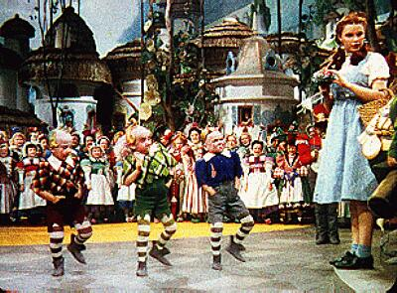
Representational Restrictions
18 U.S.C. § 207; 5 C.F.R. 2641; EO 13490
Prohibits representing another before U.S. Government with intent to influence
  Lifetime ban
  2-year ban
  1-year cooling-off period for senior employees
  Pledge paragraphs 4 and 5
“We represent the Lollipop Guild!”

Slide 7
Lifetime Ban
18 U.S.C. § 207(a)(1)
May not:
  Communicate/appear on behalf of another
  With “intent to influence”
  Regarding a “particular matter”
  Involving specific parties
  Where participated “personally and substantially” as Federal employee
  Behind-the-scenes assistance permitted

Slide 8
Communication or Appearance
5 C.F.R. 2641.201(d)
Communication – any oral, written, or electronic communication that former employee intends to be attributed to himself
No requirement that former employee be recognized by current employee
Appearance – Physically present
Behind the scenes assistance – permitted but be careful of 3rd party intermediary communications

Slide 9
Intent to Influence
5 C.F.R. 2641.201(e)
Present when made for the purpose of
  Seeking a government ruling, benefit, approval, or other discretionary action or affecting government action in a matter involving a dispute or controversy
Not Present when made for the purpose of
  Making routine requests not involving a potential controversy, factual statements not involving element of dispute or effort to seek discretionary government, and social contacts

Slide 10
Intent to Influence (cont)
Mere physical presence – relevant factors to consider set forth in 5 C.F.R. 2641.201(4)
Notes:
2641.201 d behind the scenes permits your name on application; relevant factors: former employee has authority to make decisions; has substantive responsibility in the matter; presence is relatively prominent; is paid for making the appearance; others will make reference to views of past or present work of employee; not there just for informational purposes; not there for legal presence; and not there before subordinates.

Slide 11
Particular matter involving specific parties
Particular matter – includes a judicial or other proceeding, application, request for a ruling or other determination, contract, claim, controversy, or investigation. Generally, does not include rulemaking, formulation of general policy, standards or objectives, or other matters of general application.

Slide 12
Particular matter involving specific parties
5 C.F.R. 2641.201(h)(cont)
Would not include matters of general applicability (legislation or rulemaking)
International agreements – maybe depending on focus (e.g. specific claim)
Must be specific parties at all relevant times (both when participating as a government employee and making the post-employment communication or appearance)

Slide 13
Same Particular Matter Involving Specific Parties
5 C.F.R. 2641.201(h)(5)
Contracts, grants, or agreements
  Generally new particular matter does not arise simply because of a contract modification
  Generally successive or otherwise separate contracts are new particular matters
  Generally, a contract is a single particular matter
  Individual delivery order or task order could be separate particular matter in some cases
Notes:
Party matters v. 208
Medico

Slide 14
Before an Employee of the US
5 C.F.R. 2641.201(f)
Includes any current Federal employee
Public Commentary – address at a public gathering, conference, seminar, or other similar forum as a speaker or panelist is not a prohibited communication if forum is
  Not Government sponsored or co-sponsored
  Attended by a large number of people
  Significant portion of attendees are not US employees

Slide 15
On Behalf of Another Person
5 C.F.R. 2641.201(g)
“Person” broadly defined. It includes an individual, corporation, company, association, firm, partnership, society, joint stock company or any other organization, institution, or entity.
It does not include the former employee himself or any sole proprietorship owned by the former employee

Slide 16
Personal and Substantial
Participate personally and substantially – to participate directly and significantly by decision, approval, recommendation, rendering of advice or investigation. Includes actions of a subordinate if actually directed by the former employee.

Slide 17
Representational Restrictions
2-Year Ban
18 U.S.C. § 207(a)(2). May not, within 2 years of termination of Government service
  Communicate/appear on behalf of another
  With “intent to influence”
  Regarding a “particular matter”
  Involving specific parties
  Under “official responsibility” during last year of Government service
Behind-the-scenes assistance permitted

Slide 18
Representational Restrictions
Definitions
Official responsibility – direct administrative or operating authority, whether intermediate or final, and either exercisable alone or with others, and either personally or through subordinates, to approve, disapprove, or otherwise direct Government action.
“Acting” – official responsibility may be affected
Leave status – official responsibility is not affected by annual, sick, or terminal leave, excused absence or leave without pay.
Disqualification – official responsibility is not affected

Slide 19
Representational Restrictions
1-Year Cooling-Off Period
18 U.S.C. § 207(c)
  Applies to former senior employees (personnel whose basic pay exceeded 86.5 percent of the rate for level II of the Executive Schedule (EL II).
  Prohibits communication or appearance before former agency, on behalf of another with intent to influence, on any matter where official action is sought

Slide 20
1-Year Cooling-Off Period
Behind-the-scenes assistance permitted
Communications to other DoD components permitted
Dual-Hatted

Slide 21
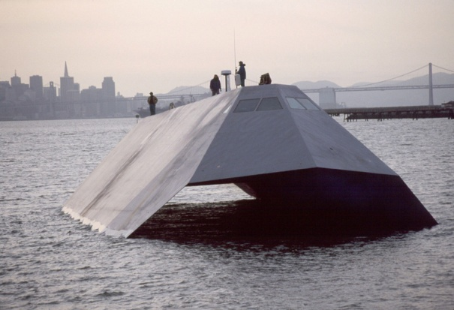
Procurement Integrity Act
No longer has a name; codified on 1/4/11 at 41 U.S.C. 2101-2107
Still Applies to employees who retire on or after 1 January 1997; just finally codified
Bars acceptance of compensation from contractor for 1 year after certain participation in procurement >
$10M
  Covers 7 positions and 7 activities
  defined in the statute

Slide 22
Executive Order 13490 and Pledge
Applies to Political Appointees
Senior Officials have 2-year cooling off
No former political appointee can lobby current political appointees in the executive branch until administration is over

Slide 23
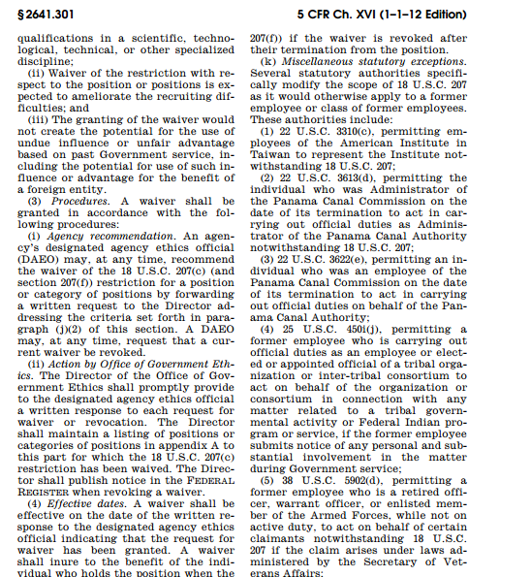
Exceptions to 18 U.S.C. § 207
Eight enumerated exceptions
*but not all of them apply to § 207(a)(1) & (2)!
Additional exceptions
found in other statutes-
see 5 C.F.R. 2641.301(k)

Slide 24

18 U.S.C. § 207 Exceptions
Exceptions / Waivers | 207(a)(1) | 207(a)(2) | 207(b) | 207 (c) | 207 (d) | 207 (f)
Official Government Duties (j)(1) | X | X | X | X | X | X
State/Local Governments & Institutions, Hospitals & Organizations (j)(2) |  |  |  | X | X
International Organizations (j)(3) | X | X | X | X | X | X
Special Knowledge (j)(4) |  |  |  | X | X
Scientific /Technological Info. (j)(5) | X | X |  | X | X
Testimony under Oath or Statements Made under Penalty of Perjury (j)(6) | X | X | X | X | X | X
Political Parties and Campaign Committees (j)(7) |  |  |  | X | X
Presidential Waiver (k) | X | X | X | X | X | X
Exceptions / Waivers | 207(a)(1) | 207(a)(2) | 207(b) | 207(c) | 207(d) | 207(f)
Official Government Duties (j)(1) | X | X | X | X | X | X
State/Local Governments & Institutions, Hospitals & Organizations (j)(2) |  |  |  | X | X
International Organizations (j)(3) | X | X | X | X | X | X
Special Knowledge (j)(4) |  |  |  | X | X
Scientific /Technological Info. (j)(5) | X | X |  | X | X
Testimony under Oath or Statements Made under Penalty of Perjury (j)(6) | X | X | X | X | X | X
Political Parties and Campaign Committees (j)(7) |  |  |  | X | X
Presidential Waiver (k) | X | X | X | X | X | X
Exceptions / Waivers | 207(a)(1) | 207(a)(2) | 207(b) | 207 (c) | 207 (d) | 207 (f)
Official Government Duties (j)(1) |  |  | X | X | X | X
State/Local Governments & Institutions, Hospitals & Organizations (j)(2) |  |  |  | X | X
International Organizations (j)(3) |  |  | X | X | X | X
Special Knowledge (j)(4) |  |  |  | X | X
Scientific /Technological Info. (j)(5) |  |  |  | X | X
Testimony under Oath or Statements Made under Penalty of Perjury (j)(6) |  |  | X | X | X | X
Political Parties and Campaign Committees (j)(7) |  |  |  | X | X
Presidential Waiver (k) |  |  | X | X | X | X
Exceptions / Waivers | 207(a)(1) | 207(a)(2) | 207(b) | 207 (c) | 207 (d) | 207 (f)
Official Government Duties (j)(1) | X | X | X | X | X | X
State/Local Governments & Institutions, Hospitals & Organizations (j)(2) |  |  |  | X | X
International Organizations (j)(3) | X | X | X | X | X | X
Special Knowledge (j)(4) |  |  |  | X | X
Scientific /Technological Info. (j)(5) | X | X |  | X | X
Testimony under Oath or Statements Made under Penalty of Perjury (j)(6) | X | X | X | X | X | X
Political Parties and Campaign Committees (j)(7) |  |  |  | X | X
Presidential Waiver (k) | X | X | X | X | X | X

Slide 25
How are the exceptions set up?
Content-Neutral
Focus on the type of entity that the former employee is representing, the status of the former employee, or other non-content based criteria.
Content-Specific
Focus on the content of the representation being made.
* the majority of exceptions
* can be tricky to use!

Slide 26
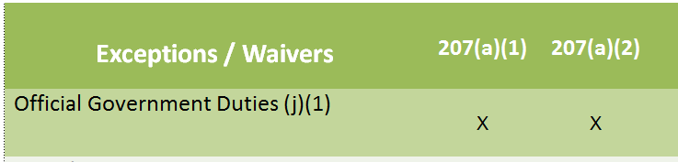
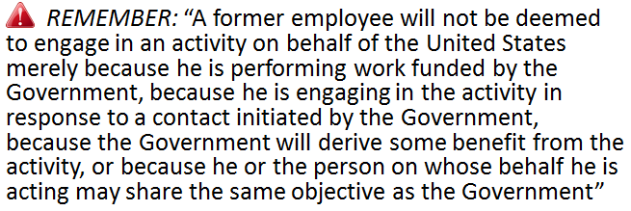
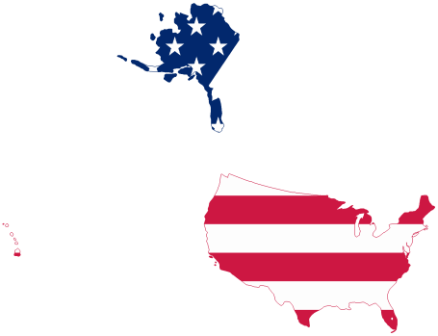
18 U.S.C. § 207(j)(1)
A former employee will not violate § 207 if his or her communication or appearance is on behalf of:
  United States;
  District of Columbia; or
  As an elected official of a State or local government.

Slide 27
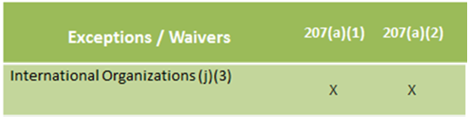

18 U.S.C. § 207(j)(3)
A former employee will not violate § 207 if his or her communication or appearance is on behalf of an international organization in which the United States participates, if the Secretary of State certifies in advance that such activity is in the interests of the United States.

Slide 28
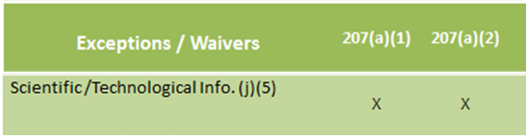

18 U.S.C. § 207(j)(5)
A former employee may make a communication solely for purposes of furnishing scientific or technological information if:
Done in accordance with Agency procedures; or
If the Agency, in consultation with OGE, publishes certification in the Federal Register that:
          The former employee has outstanding scientific or technological qualifications;
          Those qualifications are needed in the particular matter; and
          The national interest is served by the former employee’s participation.

Slide 29
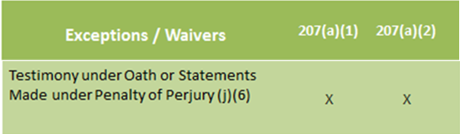

18 U.S.C. § 207(j)(6)
A former employee will not violate § 207 if he or she gives testimony under oath, or makes statements required to be made under penalty of perjury;
A former employee will not violate § 207 if he or she gives testimony under oath, or makes statements required to be made under penalty of perjury; BUT a former employee restricted by (a)(1) with respect to a particular matter can’t serve as an expert witness for anyone other than the U.S. in that matter, except per a court order.

Slide 30
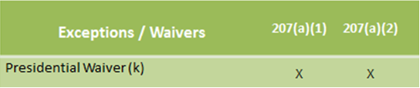

18 U.S.C. § 207(k)
The President can waive a 207 restriction “if the President determines and certifies in writing that it is in the public interest to grant the waiver and that the services of the officer or employee are critically needed for the benefit of the Federal Government.”

Slide 31
18 U.S.C. § 207 Exceptions
Exceptions / Waivers | 207(a)(1) | 207(a)(2) | 207(b) | 207(c) | 207(d) | 207(f)
Official Government Duties (j)(1) | X | X | X | X | X | X
State/Local Governments & Institutions, Hospitals & Organizations (j)(2) |  |  |  | X | X
International Organizations (j)(3) | X | X | X | X | X | X
Special Knowledge (j)(4) |  |  |  | X | X
Scientific /Technological Info. (j)(5) | X | X |  | X | X
Testimony under Oath or Statements Made under Penalty of Perjury (j)(6) | X | X | X | X | X | X
Political Parties and Campaign Committees (j)(7) |  |  |  | X | X
Presidential Waiver (k) | X | X | X | X | X | X

